Slide 1
DNA Extraction
How can we get DNA out of cells?
Notes:
Strawberry DNA - 5 min demo + 20 minutes student stuff

Slide 2
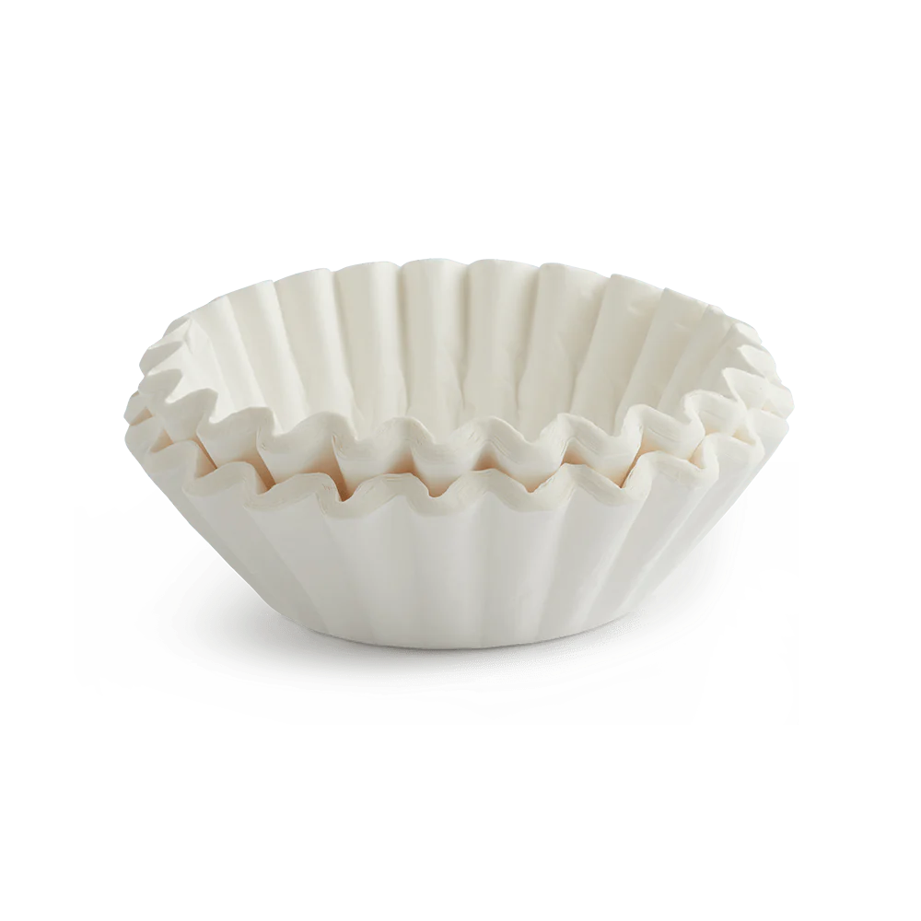

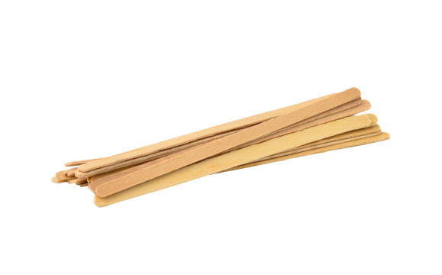
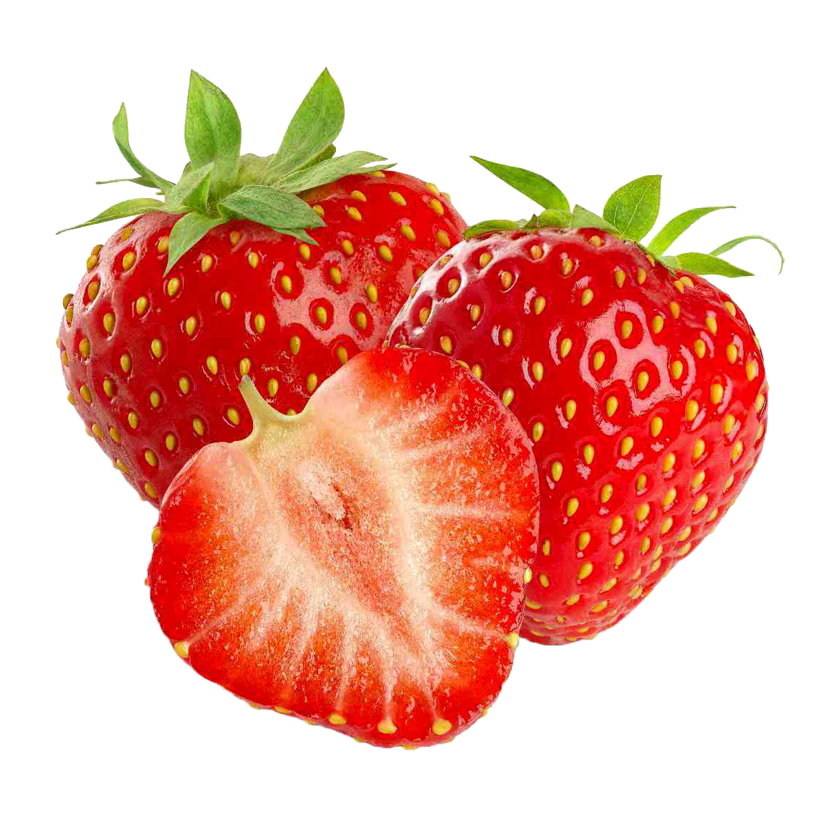
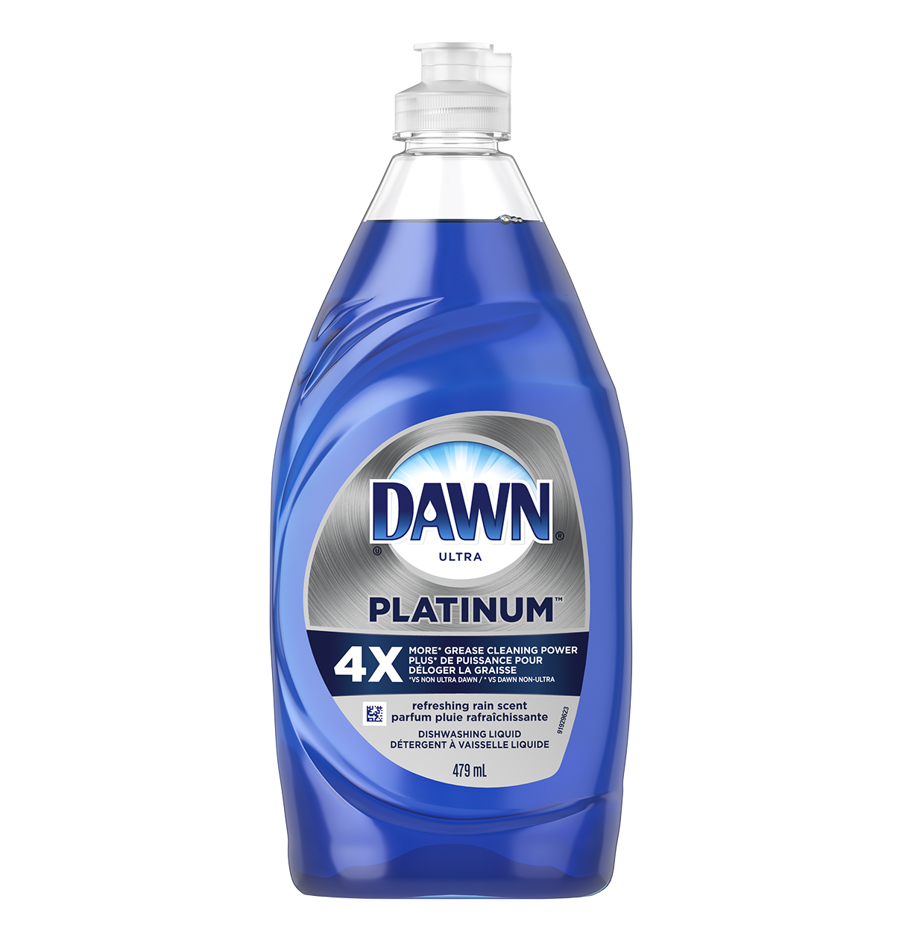
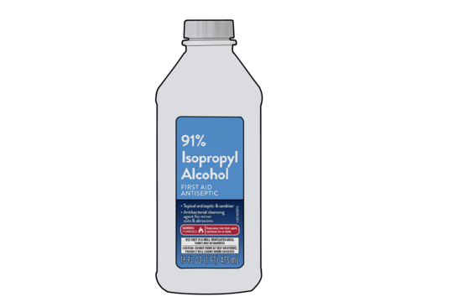
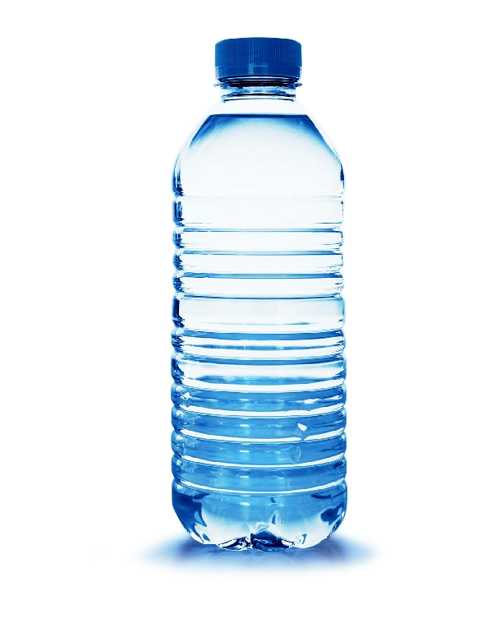
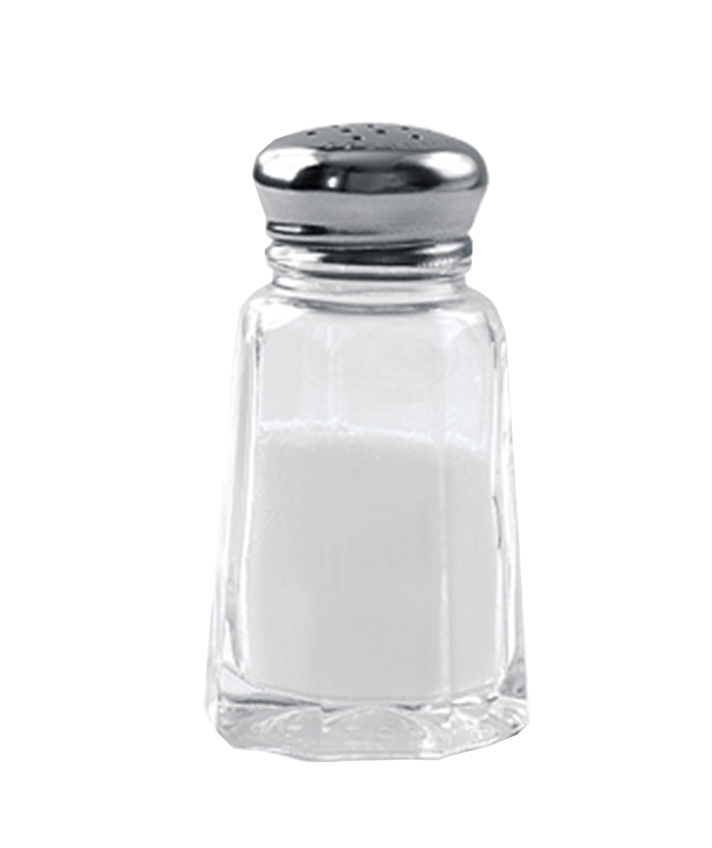
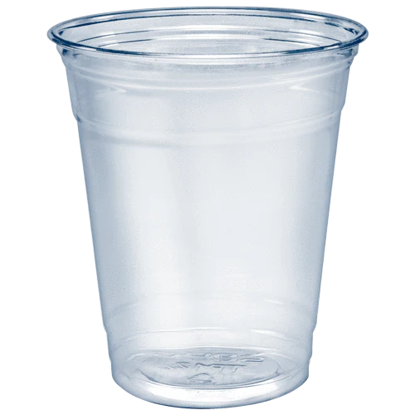
Materials

Slide 3
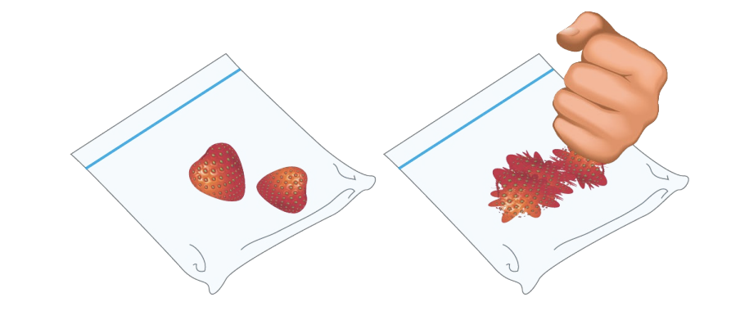
Step 1: Smash the cells!
-Pull off any green leaves on the strawberry.
- Put the strawberries into the plastic bag and SEAL THE PLASTIC BAG.
-Smash the strawberries for about two minutes to break open the cells and release the DNA!
Fun fact: When cells break open, it is called “lysing”!

Slide 4
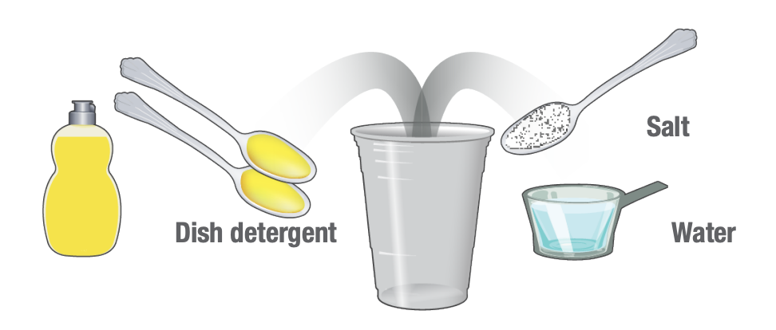
Step 2: Prepare your extraction liquid
-Mix in a plastic cup:
- 2 teaspoons dish soap
- 1 teaspoon salt
- 1/2 cup of water
-This will be your DNA extraction liquid!

Slide 5
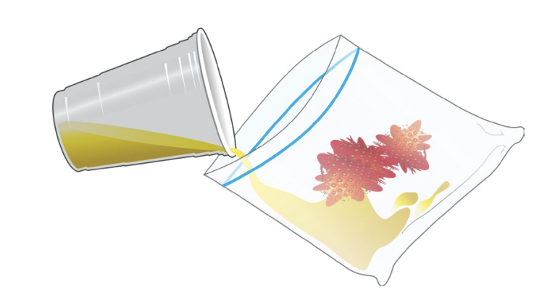
Step 3: Chemically lyse cells!
-Pour DNA extraction liquid into the bag with the strawberries
→ This will further break open the cells.
-Reseal the bag and gently smash for another minute.
Avoid making too many soap bubbles!
Question: Why do we use chemicals in addition to mechanically crushing the cells?

Slide 6
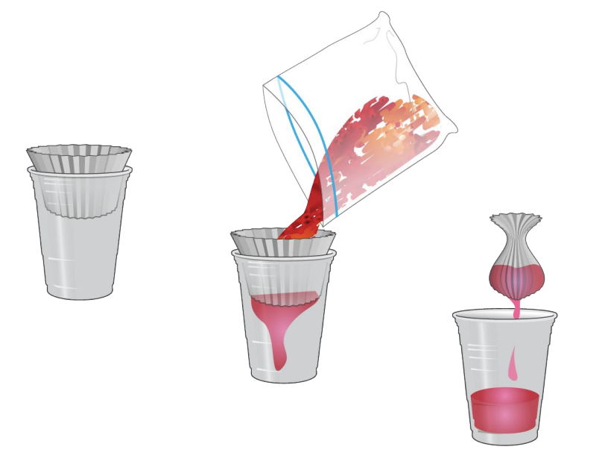
Step 4: Filtering
- Place the coffee filter inside the second plastic cup.
- Open the bag and pour the strawberry liquid into the filter.
- Twist the filter just above the liquid and gently squeeze the remaining liquid into the cup.
Question: What are we filtering out here? What’s in the filtrate?

Slide 7
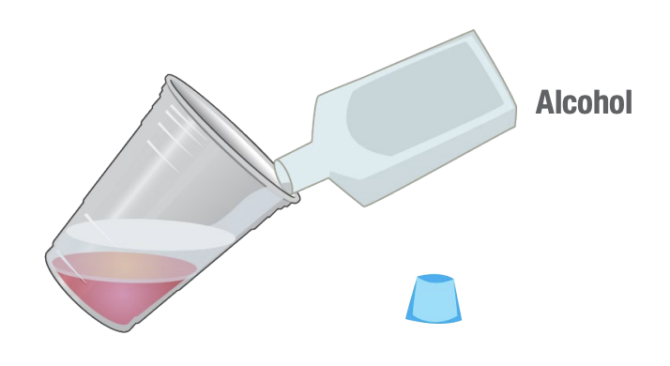
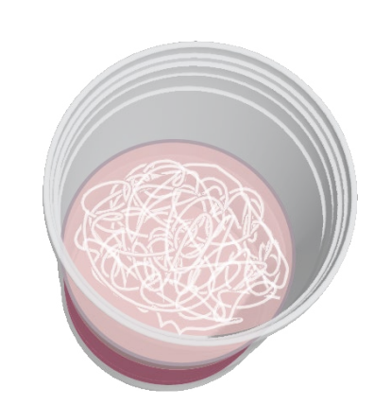
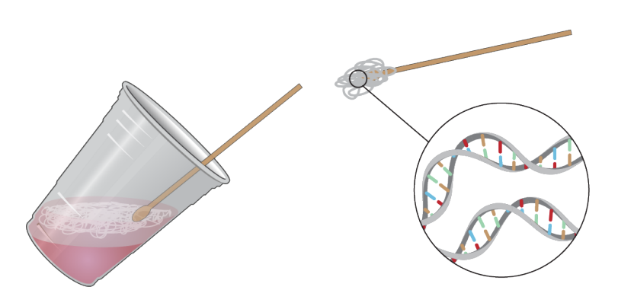
Step 5: Extract the DNA!
Pour an equal amount of rubbing alcohol as there is strawberry liquid down the side of the cup. Do not mix or stir.
Within a few seconds, watch for a white cloudy substance (DNA) to develop in the top layer. You have just isolated the DNA from the rest of the material contained in the cells of the strawberry.
Tilt the cup and pick up the DNA using a coffee stirrer.

Slide 8
DNA Extraction: How did this work?
Why do we use the dishwashing liquid?
Hint: Cell membranes are made of lipids (fats), and soap breaks down fats.
Why do we use the salt?
Hint: Proteins are bound up with the DNA molecules, and these interactions are ionic!
What does the alcohol do?
Hint: DNA is NEGATIVELY CHARGED (POLAR), and alcohol is NONPOLAR. Like dissolves like!
→ The dishwashing liquid bursts open the cells of the strawberries, releasing the DNA.
→ It ensures that the proteins in the cell are kept separate from the DNA.
→ When molecules are insoluble (unable to be dissolved), they clump together and become visible (AKA precipitate). DNA is not soluble in alcohol; therefore, it makes the DNA strands clump together and become visible to the naked eye.

